Slide 1
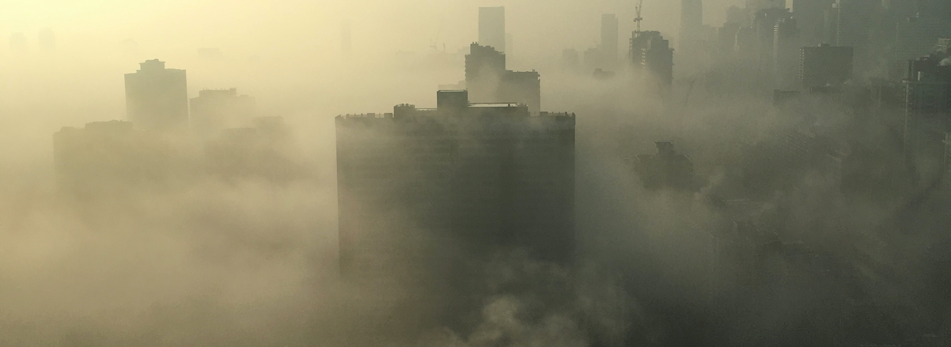
AQI vs death rate prediction
Nattawaree Piyarat
Brainstation – data science bootcamp

Slide 2

Problem statement
Can machine learning predict the death rate against the Air Quality Index (AQI)?
Is there any relationship between air quality and health (death rate) and what factors impact air quality? Nowadays, we know what impact air pollution (wildfire, dust, car, manufacturing)
Focus group AQI and number of deaths in selected Asian countries.
  Bangladesh
  Bhutan
  India
  Indonesia
  Sri Lanka
  Thailand
Notes:
Factor

Slide 3
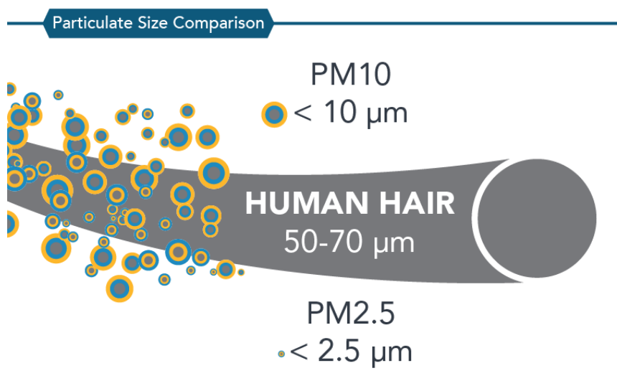
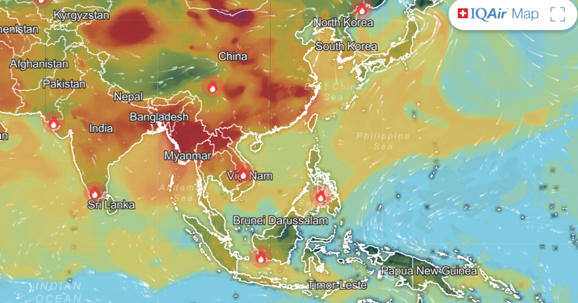
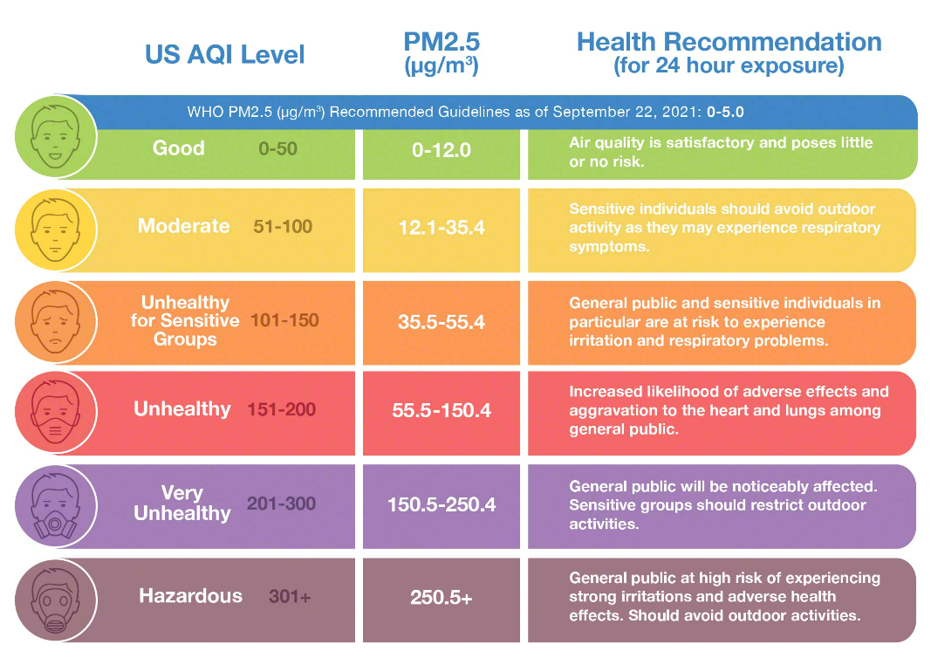
AQI (Air quality index)
Picture from IQAir website
PM 2.5 meaning: Fine particulate matter is defined as particles that are 2.5 microns or less in diameter

Slide 4
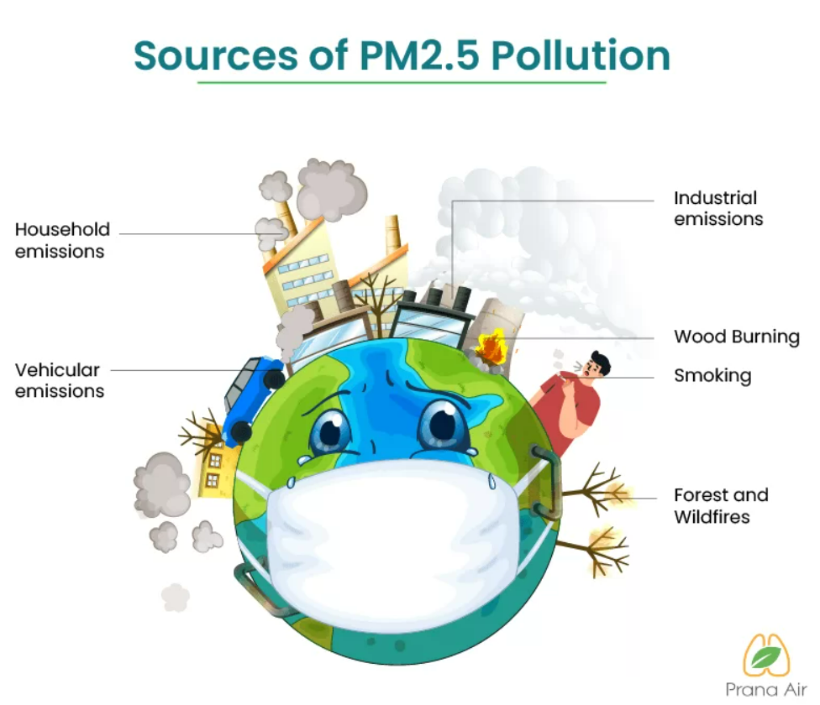
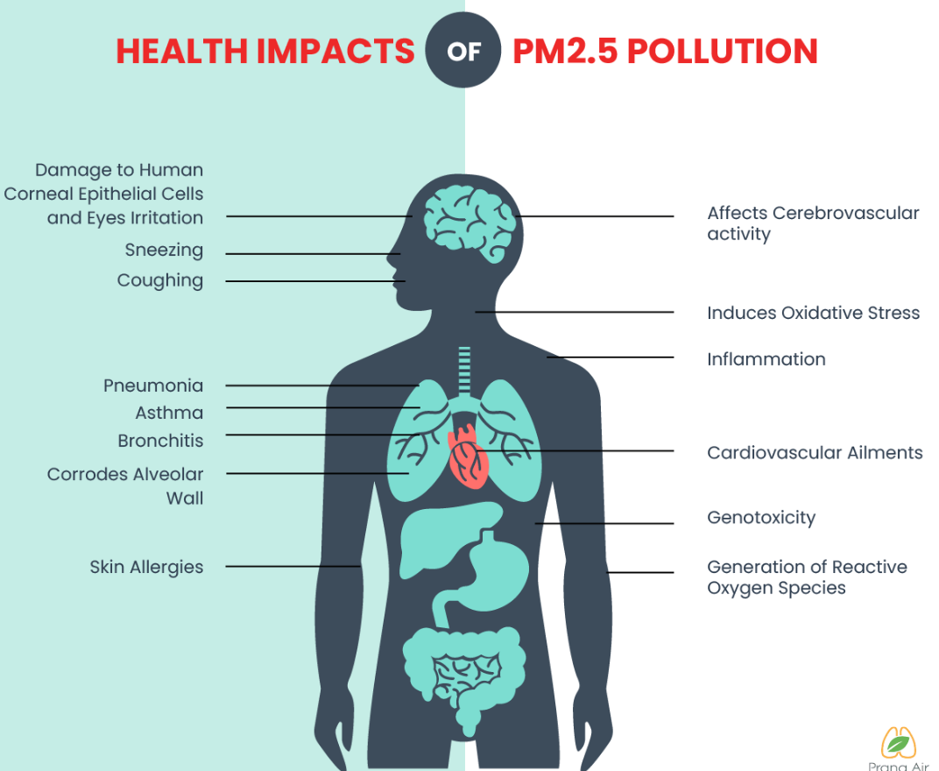

Slide 5




Data Science
The machine learning approach will use historical AQI data, and historical death causes data. And predict the relationship between air quality and the number of deaths which is assumed caused by high AQI.
Approach
  Linear Regression
  Logistic Regression
  Time series
The results of this project should raise awareness of air pollution and reduce the number of deaths of people by at least 1%, especially in the concerned areas.

Slide 6


Data set
Dataset from WHO database (Air quality index, number of deaths by cause, pollution, dust, wildfire)
Currently, I reference the datasets below.
Air quality index year 2000 – 2019 from WHO
  Country, City
  Year
  Number of PM10, PM2.5, NO2
Number of deaths by cause year 2016 – 2019 from WHO
  Country
  Year
  Age group
  Cause of death
  Number of deaths, death rate
Additional dataset
  Historical AQI with many pollutants to predict AQI

Slide 7
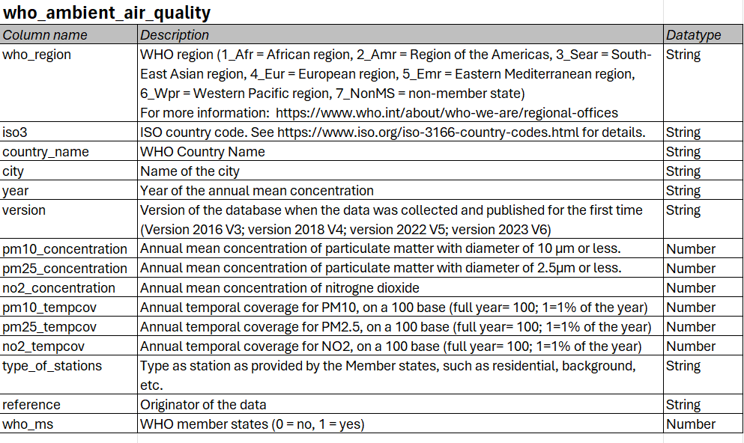
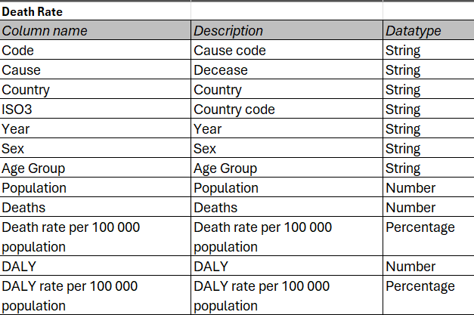
Data dictionary

Slide 8
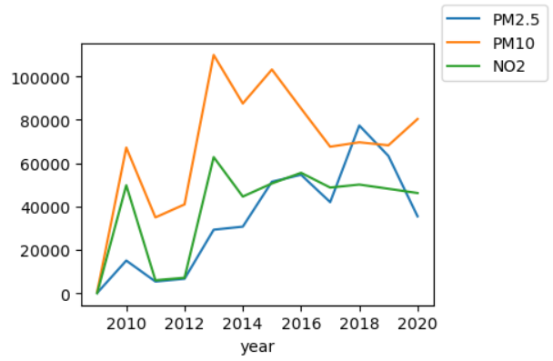
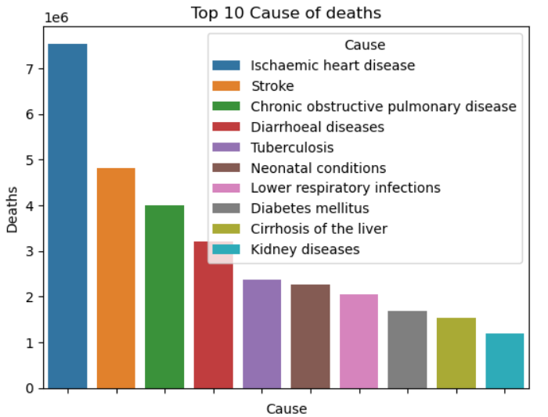
Finding (1)
PM 10 peaked during 2013 – 2015 and PM2.5 increased and peaked in 2018.
'Ischaemic heart disease' is the top 1 of the cause of death.
The WHO explains that the cause came from household air pollution which is the top of outdoor air pollution.
Notes:
Remove 20-22

Slide 9
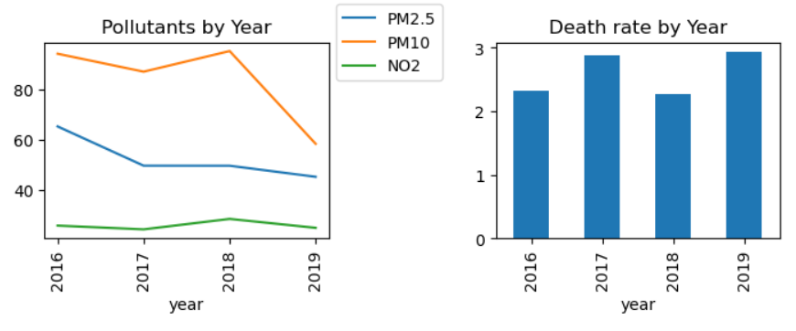
Finding(2)
Observation 2019 pollutants tend to reduce but the death rate increases which can assume that the pollution was not impact immediately but needs some years to be affected.

Slide 10
Finding(3)
Linear Regression | X | Result (R²)
y = number of deaths | PM10 | 0.31
 | PM2.5 | 0.32
 | PM10, PM2.5 | 0.48
Logistic Regression | X | Result (R²)
y = Unhealthy | PM10, PM2.5, NO2 | 1
Focus only on 'Ischaemic heart disease’ the Death rate correlates with PM10, PM2.5

Slide 11
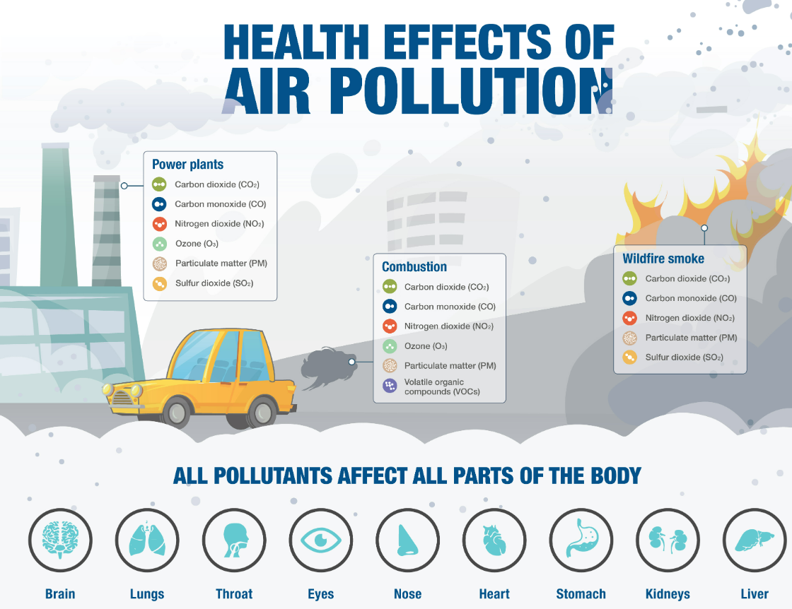

Slide 12
Next step
Since the impact of the air quality index (AQI) on mortality takes time to become evident, it's crucial to forecast AQI based on each pollutant.Add more datasets that contain many pollutants (O₃, PM2.5, PM10, CO₂, NO₂, CO, SO₂)
Using machine learning to predict AQI and Death rate
  Time series
  Decision Tree
  KNN
Notes:
ozone, fine particulate matter, nitrogen dioxide, carbon monoxide, sulphur dioxide and total reduced sulphur compounds.

Slide 13


Slide 14
Reference
WHO. WHO Ambient Air Quality Database (update 2023). Version 6.0. Geneva, World Health Organization, 2023.

